Slide 1
Recap:
Time Series Decomposition
Data Pre-Processing
Exponential Smoothing
Chris Martin | chrisgmartin2@gmail.com DATA624 – Predictive Analytics
February 27, 2018
Pt 1 https://youtu.be/F7iOcCKBYcU | Pt 2 https://youtu.be/H2YF9Fn1vfU | Pt 3 https://youtu.be/H2YF9Fn1vfU

Slide 2
Times Series Decomposition

Slide 3
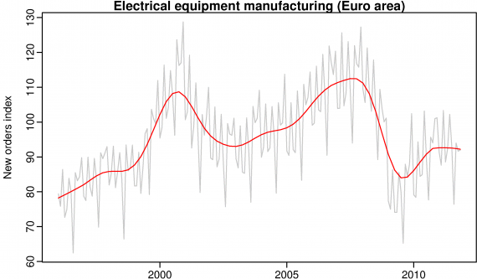
Time Series Decomposition
Seasonal
Trend
Cycle
Time Series Components
Seasonal: S_{t}
Trend: T_{t}
Remainder: E_{t}

Slide 4
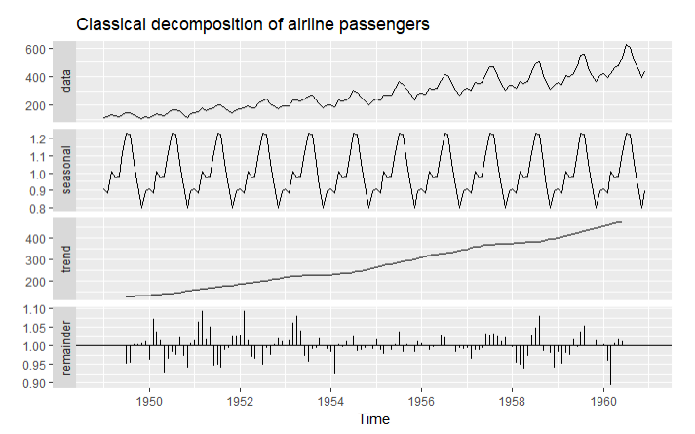
Time Series Components
Time Series Decomposition
Seasonal: S_{t}
Trend: T_{t}
Remainder: E_{t}
Additive Decomposition:
Y_{t} = S_{t} + T_{t} + E_{t}
Useful when seasonal variation is relatively constant over time
Multiplicative Decomposition:
Y_{t} = S_{t} x T_{t} x E_{t}
Useful when seasonal variation increases over time

Slide 5
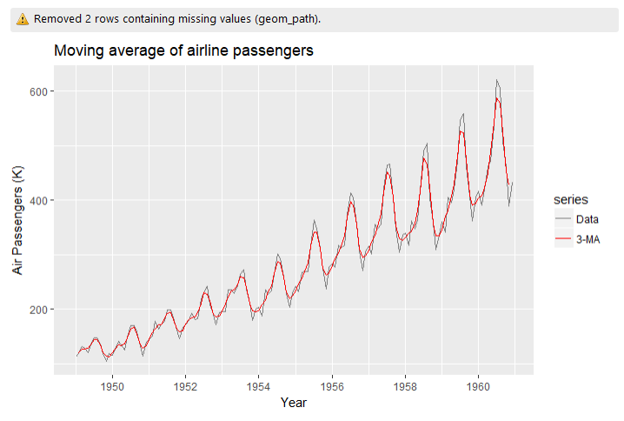

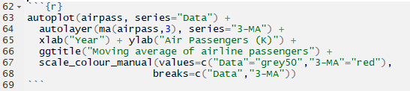

Moving Average
Time Series Decomposition
Used for smoothing
m=2k+1
Weighted Moving Average
Used for smoothing, averaging using weights for the time period
k=(m-1)/2
Example: m=3

Slide 6
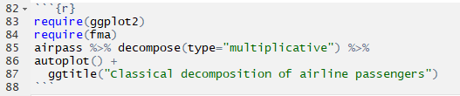
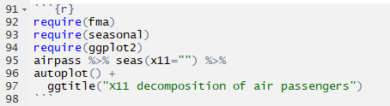
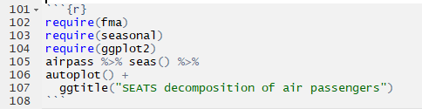
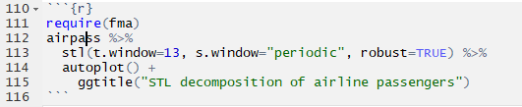
Decomposition Types
Time Series Decomposition
Classical
ARIMA X11 → X12 → X13
SEATS
STL
Adjust trend window
Adjust seasonality window

Slide 7
Decomposition Types
Time Series Decomposition
Commonly used
Not recommended
Classical
ARIMA X11 → X12 → (X13)
SEATS
STL
Improvement over classical
Works only for quarterly and monthly
Improvement over classical
Works only for quarterly and monthly
R package: ‘x12’ (12/5/2017)
Seasonal Extraction in ARIMA Time Series
Works only for quarterly and monthly
Similar to ARIMA X11
Seasonal Trends Loess
Handles all types of seasonality
Adjust trend window
Adjust seasonality window
Only for additive decomposition*
*without transformation of the data

Slide 8
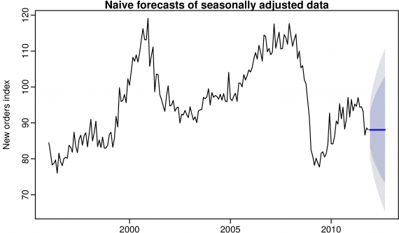

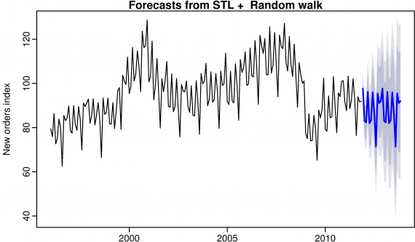

Forecasting
Time Series Decomposition
Additive decomposition:
y_{t} = S^_{t} + A^_{t}
Where A^_{t} = T^_{t} + E^_{t} for seasonal adjustment
Multiplicative decomposition:
Y_{t} = S^_{t} A^_{t}
Where A^_{t} = T^_{t} E ^_{t} for seasonal adjustment

Slide 9
Data Pre-Processing

Slide 10
Overview
Data Pre-Processing
The need for data pre-processing is determined by the type of model being used.
Transformations can lead to improvements in performance and accuracy
Modifying predictors can increase clarity of data and bring new, more accurate predictors or remove data points with lack of information
Combinations of predictors can be more effective than using the individual predictors themselves
Transformations
Modifying
Combinations

Slide 11




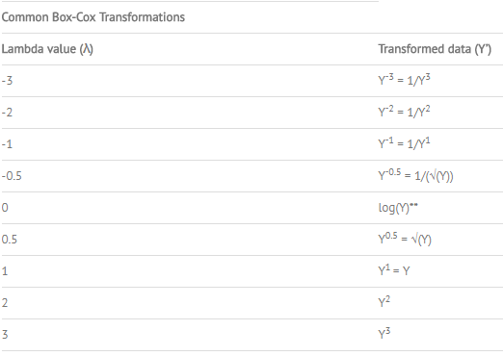
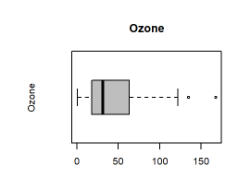
Transformations
Data Pre-Processing
Centering standardizes predictors to mean of zero
Scaling standardizes to a standard deviation of one
Centering and Scaling
Resolving Skewness
Resolving Outliers
Skew (asymmetry) can be adjusted by using the Box-Cox transformation, based on λ*
Positive values Negative values
Outliers typically indicate invalid errors**; several predictive models are insensitive to outliers
Spacial sign can project the predictor into a sphere with all samples the same distance from the center
Outliers
*Sample of Box-Cox transformation and choice of λ
**Outliers should not be hastily removed or changed, they could be realistic data points

Slide 12
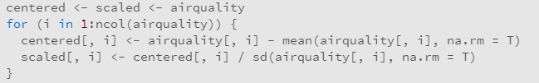
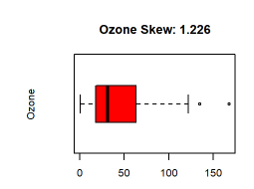
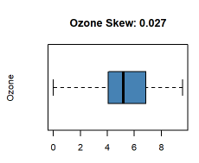
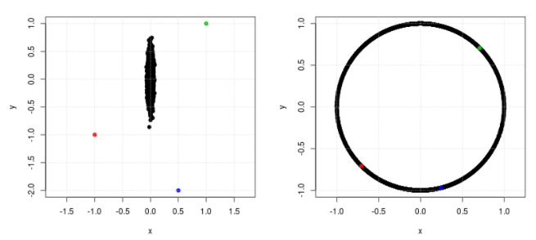
Transformations
Data Pre-Processing
Centering and Scaling
Resolving Skewness
Resolving Outliers
Before and after Box-Cox transformation
Before and after spacial sign transformation

Slide 13
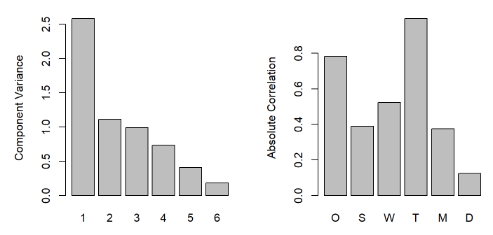
Dimensionality Reduction
Data Pre-Processing
Dimensionality Reduction methods reduce data by generating a smaller set of predictors (Feature Extraction) that capture the majority of information from original variables
Principal Component Analysis (PCA) extracts linear combinations of the predictors that maximize variability*
Feature Extraction
Principal Component Analysis (PCA)
O=Ozone, S=Solar, W=Wind, T=Temp, M=Month, D=Day
*Predictors are likely better transformed, centered, and/or scaled before PCA

Slide 14
Missing Values
Data Pre-Processing
Informative Missingness is when the pattern of missing data is related to the outcome
Informative Missingness
Structurally Missing
Censored Data
Structurally Missing data is when data is missing according to the structure of the data
(i.e. number of children a man has given birth to)
Multivariate Imputation by Chained Equations (MICE) assumes values are missing at random and imputes values based on linear regression
Predictive Mean Matching (PMM) uses a nearest-neighbor method to estimate values based on observed covariates
Censured Data is when the information has been censured in a formal manner or using a censoring mechanism

Slide 15
Predictors
Data Pre-Processing
Removing Predictors can decrease computational time and complexity
Degenerate Distributions: (near) zero variance predictor
Collinearity: highly correlated predictors, redundancy
Removing
Adding
Binning
Adding Predictors can decompose a predictor into more specific variables, or add insights to data
Categorical-to-binary: using dummy variables for cat.
Word-2-vec, Image-2-vec, etc.: converts items to vector
Binning is segregating (or categorizing) data into groups
Manually binning should be avoided (especially in pre-processing)
Several models estimate bins automatically in the process of model building using statistically sound methods

Slide 16
Exponential Smoothing

Slide 17

Overview
Exponential Smoothing
“Forecasts produced using exponential smoothing methods are weighted averages of past observations, with the weights decaying exponentially as the observations get older.”

Slide 18

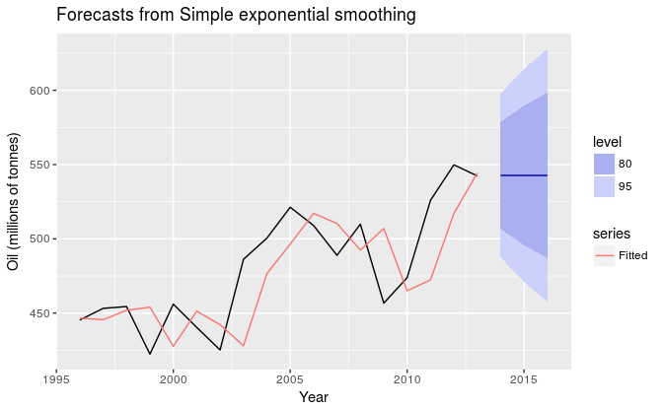
Simple Exp. Smoothing (SES)
Exponential Smoothing
Suitable for forecasting data with no trend or seasonal pattern, weighted average
Component form: not useful in itself but easiest to use when adding other components
= level = smoothed value of the series at time t
= smoothing parameter for the level

Slide 19

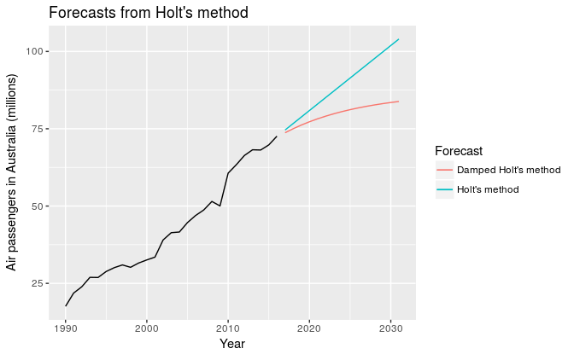

Holt’s Linear Trend Method
Exponential Smoothing
Extended SES, adds a constant trend indefinitely into the future
= estimate of the trend slope of the series at time t
= smoothing parameter for the trend
Damped Trend methods: ‘dampens’ a trend to a flat line some time in the future
Proven to be successful, and popular method for forecasting automatically
= dampening parameter*
*In practice is rarely less than 0.8 as the damping has a very strong effect for smaller values. Values of close to 1 will mean that a damped model is not able to be distinguished from a non-damped model. For these reasons, we usually restrict to a minimum of 0.8 and a maximum of 0.98.

Slide 20
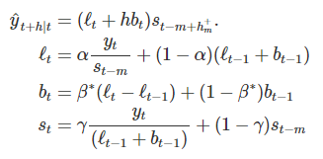
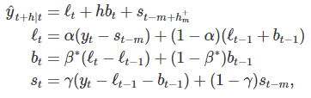
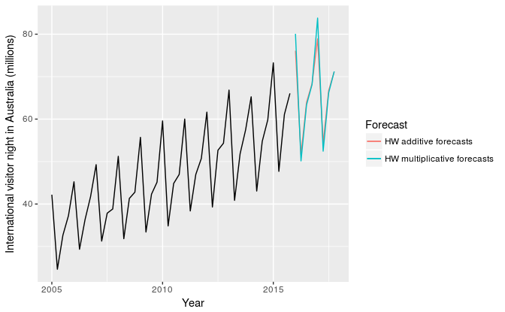
Holt-Winter’s
Exponential Smoothing
Extended to included seasonality Multiplicative Method
Additive Method
= smoothing parameter for seasonality
Additive: Preferred when seasonal variations are roughly consistent
Multiplicative: Preferred when seasonal variations are changing proportional to the level of the series

Slide 21
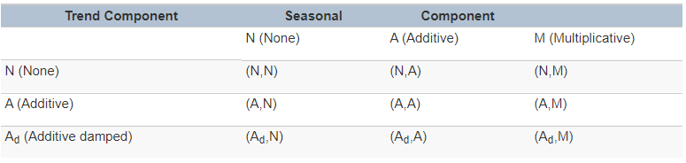
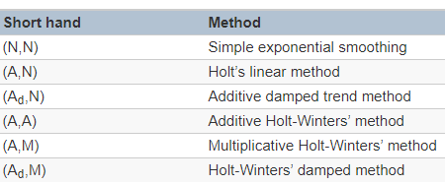
Taxonomy
Exponential Smoothing
Two-way classification of exponential smoothing methods

Slide 22
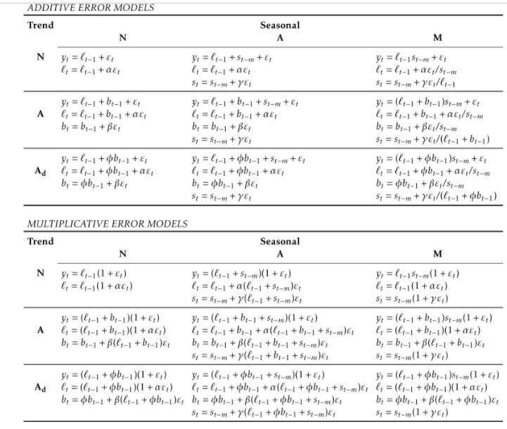
State Space Models (ETS)
Exponential Smoothing
Alternative to estimating parameters (by estimating SSE) is to maximize the ‘likelihood’ (probability of data arising from the model). Large likelihood is associated with a good model.
Can give different results for multiplicative error models from SSE

Slide 23



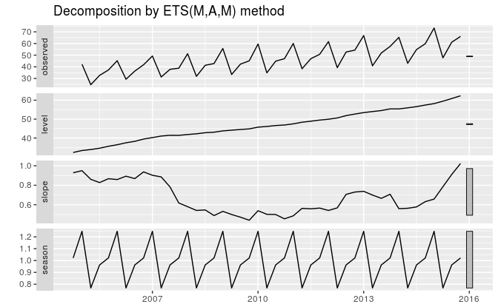
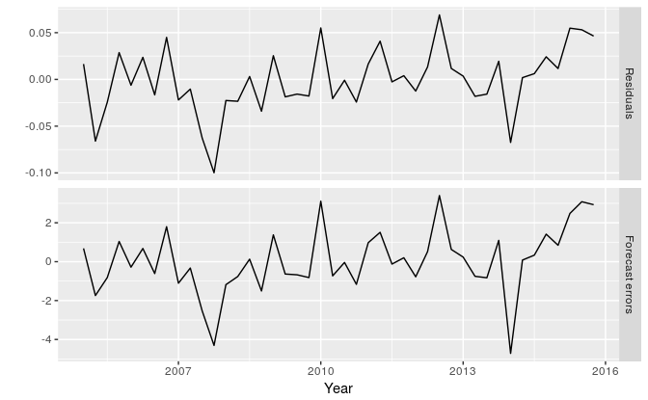
Model Selection
Exponential Smoothing
AIC = likelihood of the model = total number of parameters/states estimated
AIC_{c}
Bayesian Information Criterion (BIC)
ets()

Slide 24
Time Series Decomposition
Resources
Data Pre-Processing
Exponential Smoothing
Forecasting: Principals and Practice - https://www.otexts.org/fpp/6/1
Forecasting: Principals and Practice (2) - https://otexts.org/fpp2/seats.html
Decomposition Models- https://onlinecourses.science.psu.edu/stat510/?q=book/export/html/69
Decomposition of Time Series - https://en.wikipedia.org/wiki/Decomposition_of_time_series
Jose Zuniga’s Presentation - http://rpubs.com/josezuniga/358606
http://www.statisticshowto.com/box-cox-transformation/
https://www.promptcloud.com/blog/what-happens-between-data-extraction-visualization
https://stackoverflow.com/questions/28194655/r-is-spatialsign-function-useful-for-identifying-outliers
https://www.theanalysisfactor.com/centering-and-standardizing-predictors/
https://en.wikipedia.org/wiki/Missing_data
https://otexts.org/fpp2/ses.html
https://www.otexts.org/fpp/7/1
https://www.youtube.com/watch?v=KJnj9YUANpM
https://www.youtube.com/watch?v=qgzgDjVq6rk

